Slide 1
22jjjjjjjjjj
Mobile Application Development
MOBILE REDDIT CLIENT
Group 24 - ICT
BI12 - 227 - Lê Đức Kiên
BI12 - 192 - Bạch Ngọc Hưng
BI12 - 298 - Hoàng Vũ Hải Nam
BI12 - 213 - Đoàn Phú Khoa
BI12 - 137 - Thái Trường Giang
BI12 - 229 - Võ Minh Kiệt

Slide 2
Table of Content
Introduction
Design & Activities
Implementation
Demo

Slide 3
Introduction
Activities & Design
Implementation
Demo
ABOUT OUR APPLICATION

Slide 4

Introduction
Activities & Design
Implementation
Demo

Slide 5
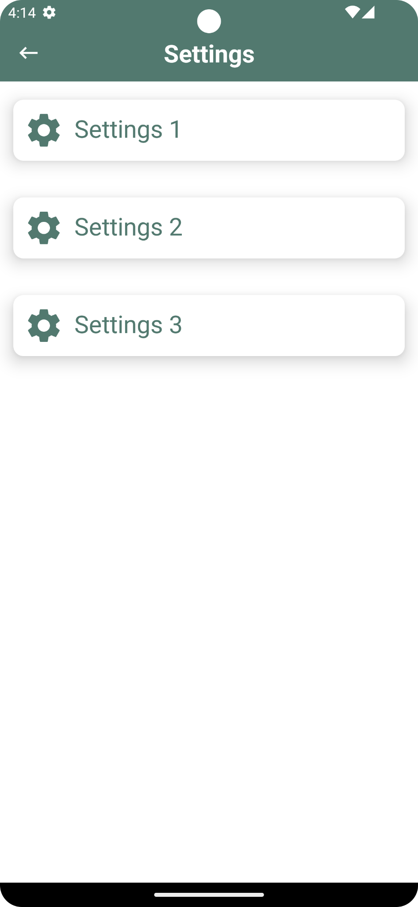
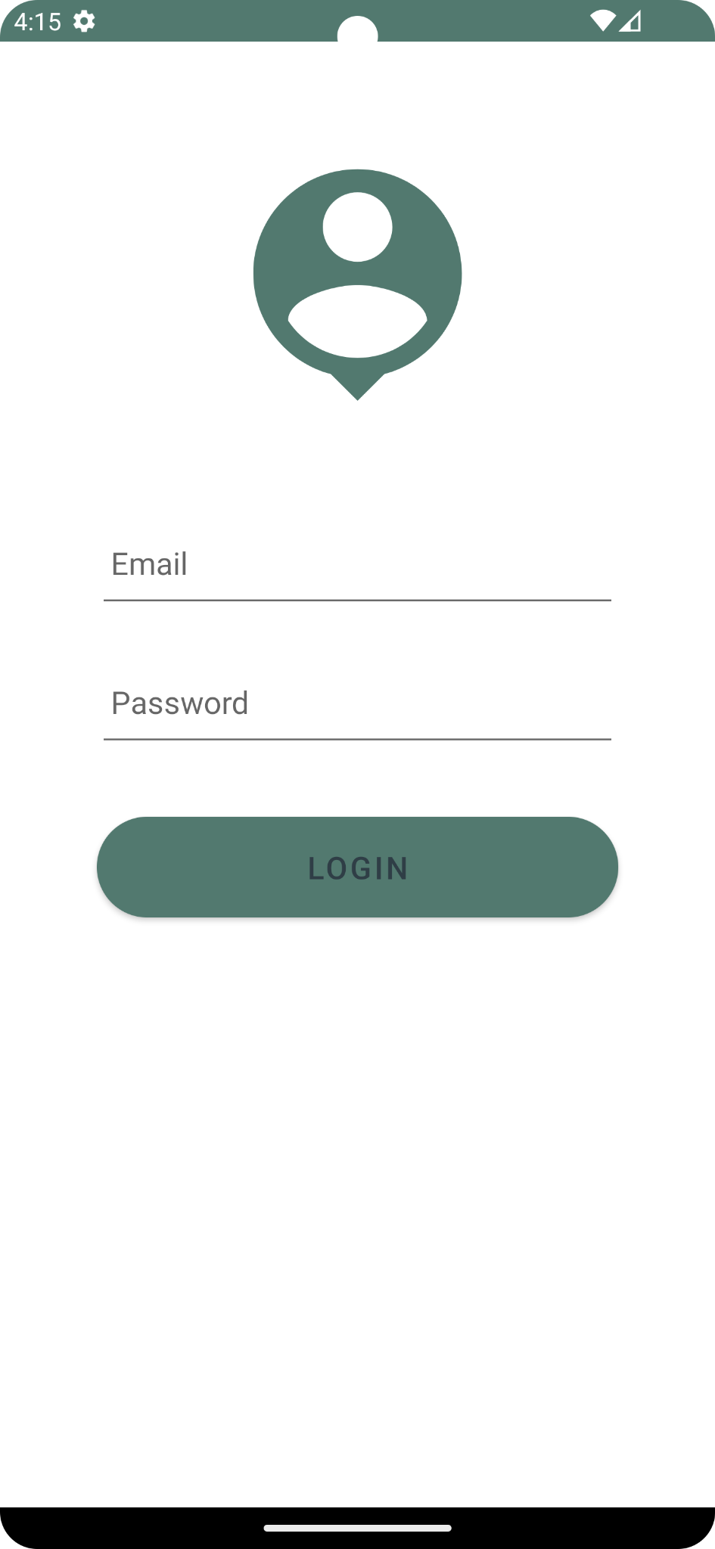
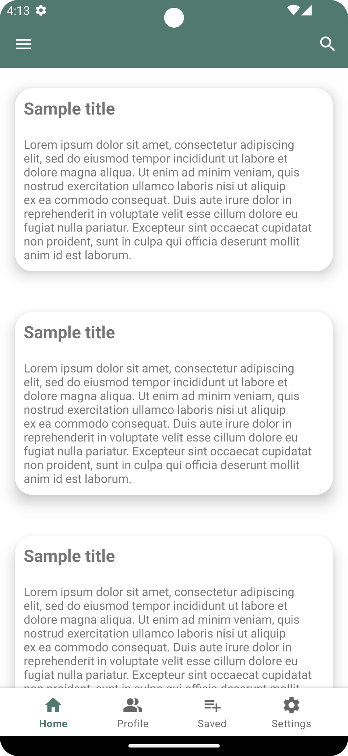
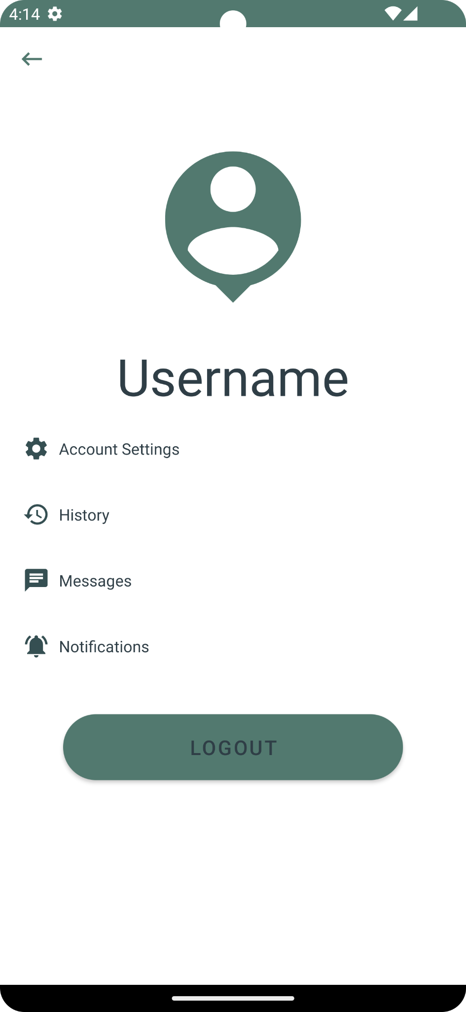
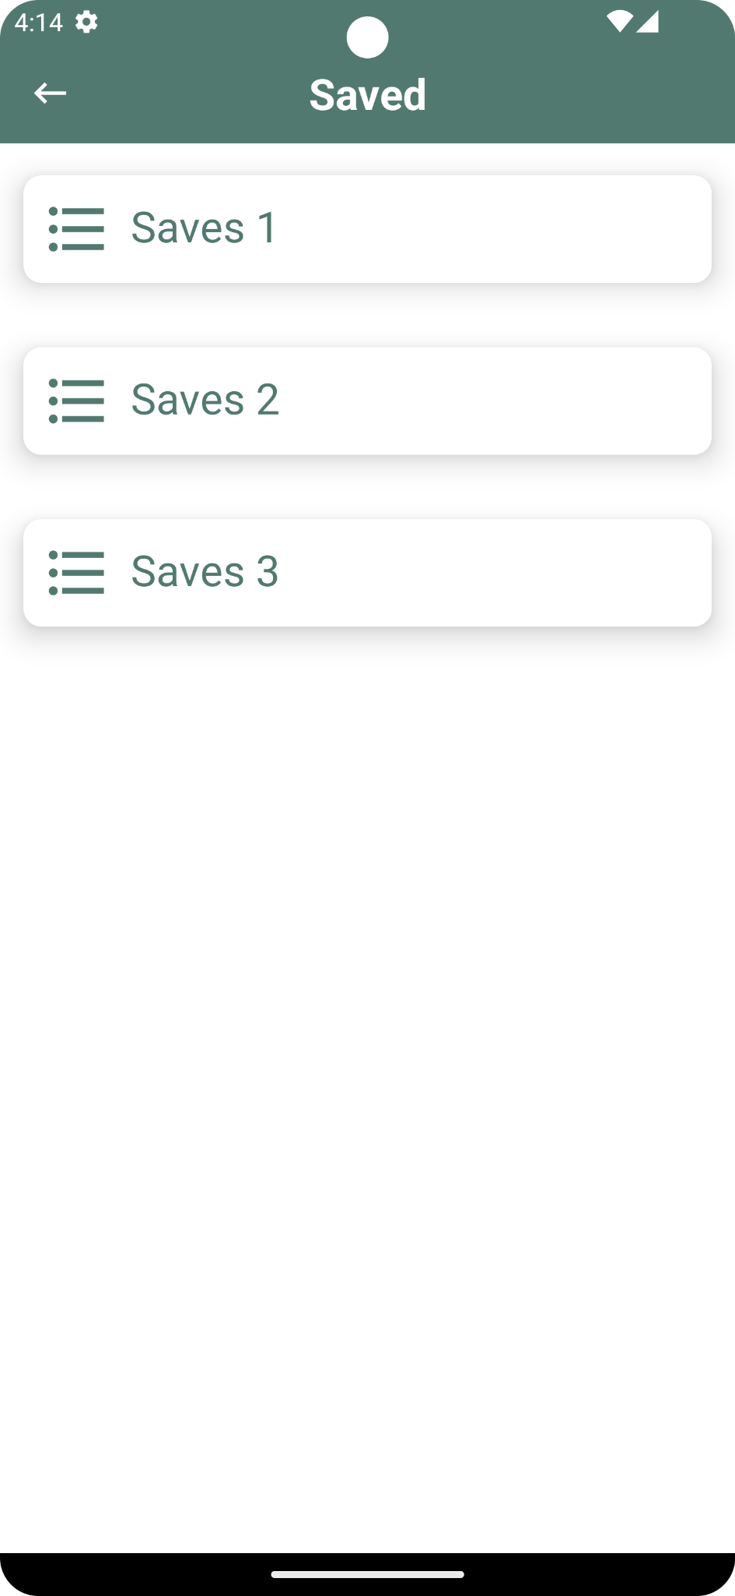
Introduction
Activities & Design
Implementation
Demo

Slide 6
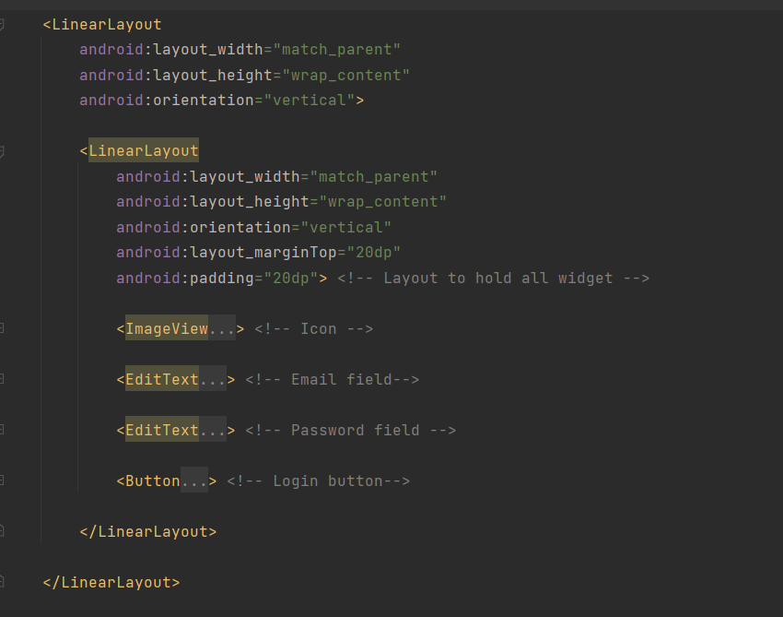
Introduction
Activities & Design
Implementation
Demo

Slide 7
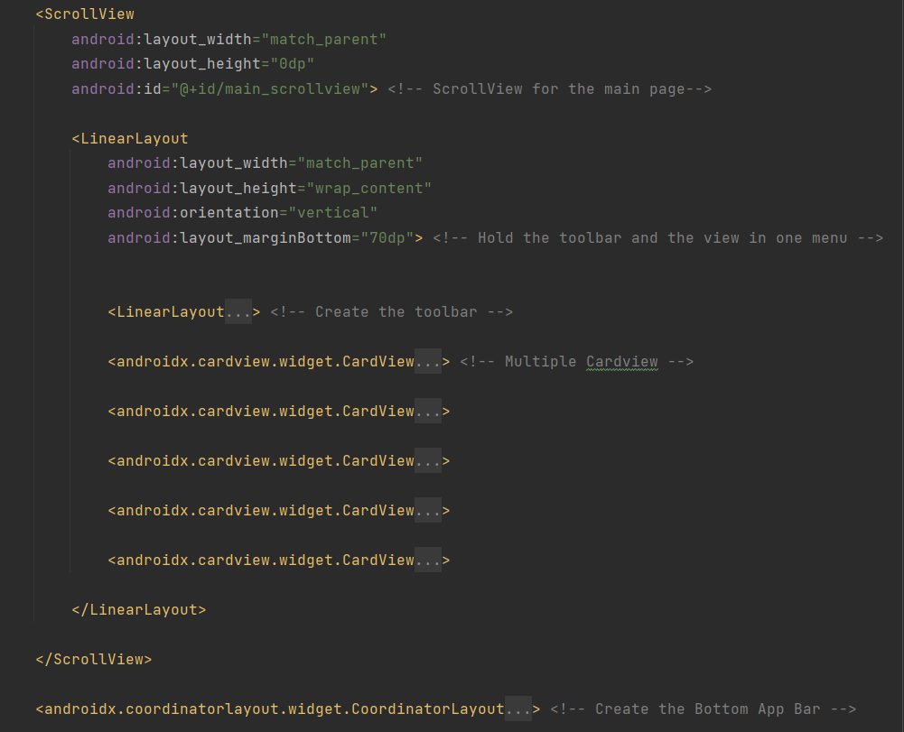
Introduction
Activities & Design
Implementation
Demo

Slide 8

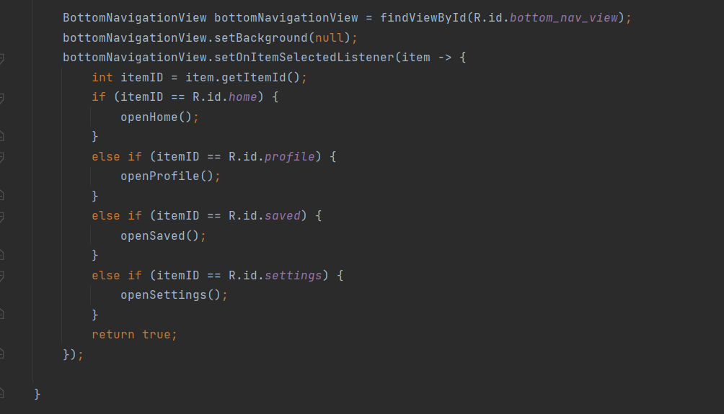
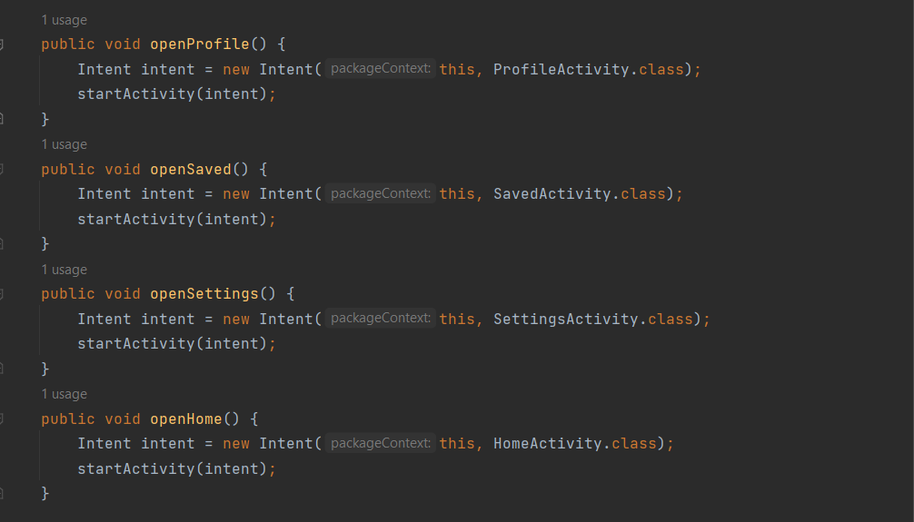
Introduction
Activities & Design
Implementation
Demo

Slide 9
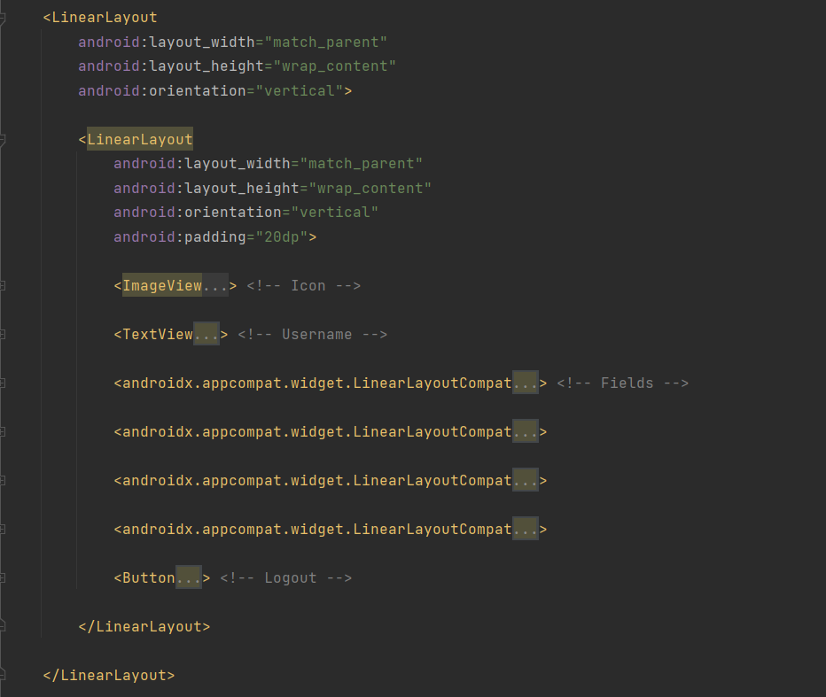
Introduction
Activities & Design
Implementation
Demo

Slide 10
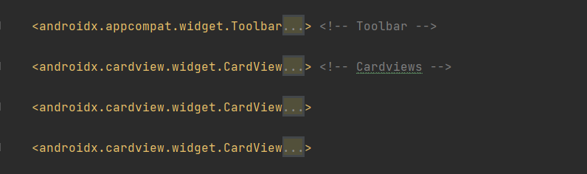
Introduction
Activities & Design
Implementation
Demo

Slide 11
Introduction
Activities & Design
Implementation
Demo

Slide 12
Introduction
Activities & Design
Implementation
Demo
APPLICATION DEMONSTRATION

